Slide 1


Slide 2
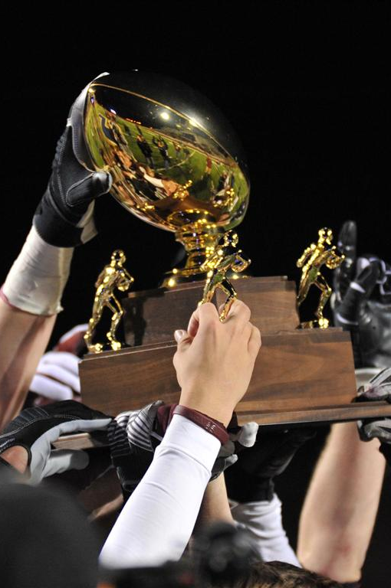
Path to Victory!
Sports give us something much greater than winning or losing. They often define who we are at any given point of time. Who we are refers to emotionally, mentally, physically, and spiritually.
As people we are on a “JOURNEY.” That journey is to grow to know the “truth” about who we are and what makes us fail or succeed! It also tells us about the choices we have as we follow this path to a destiny!

Slide 3
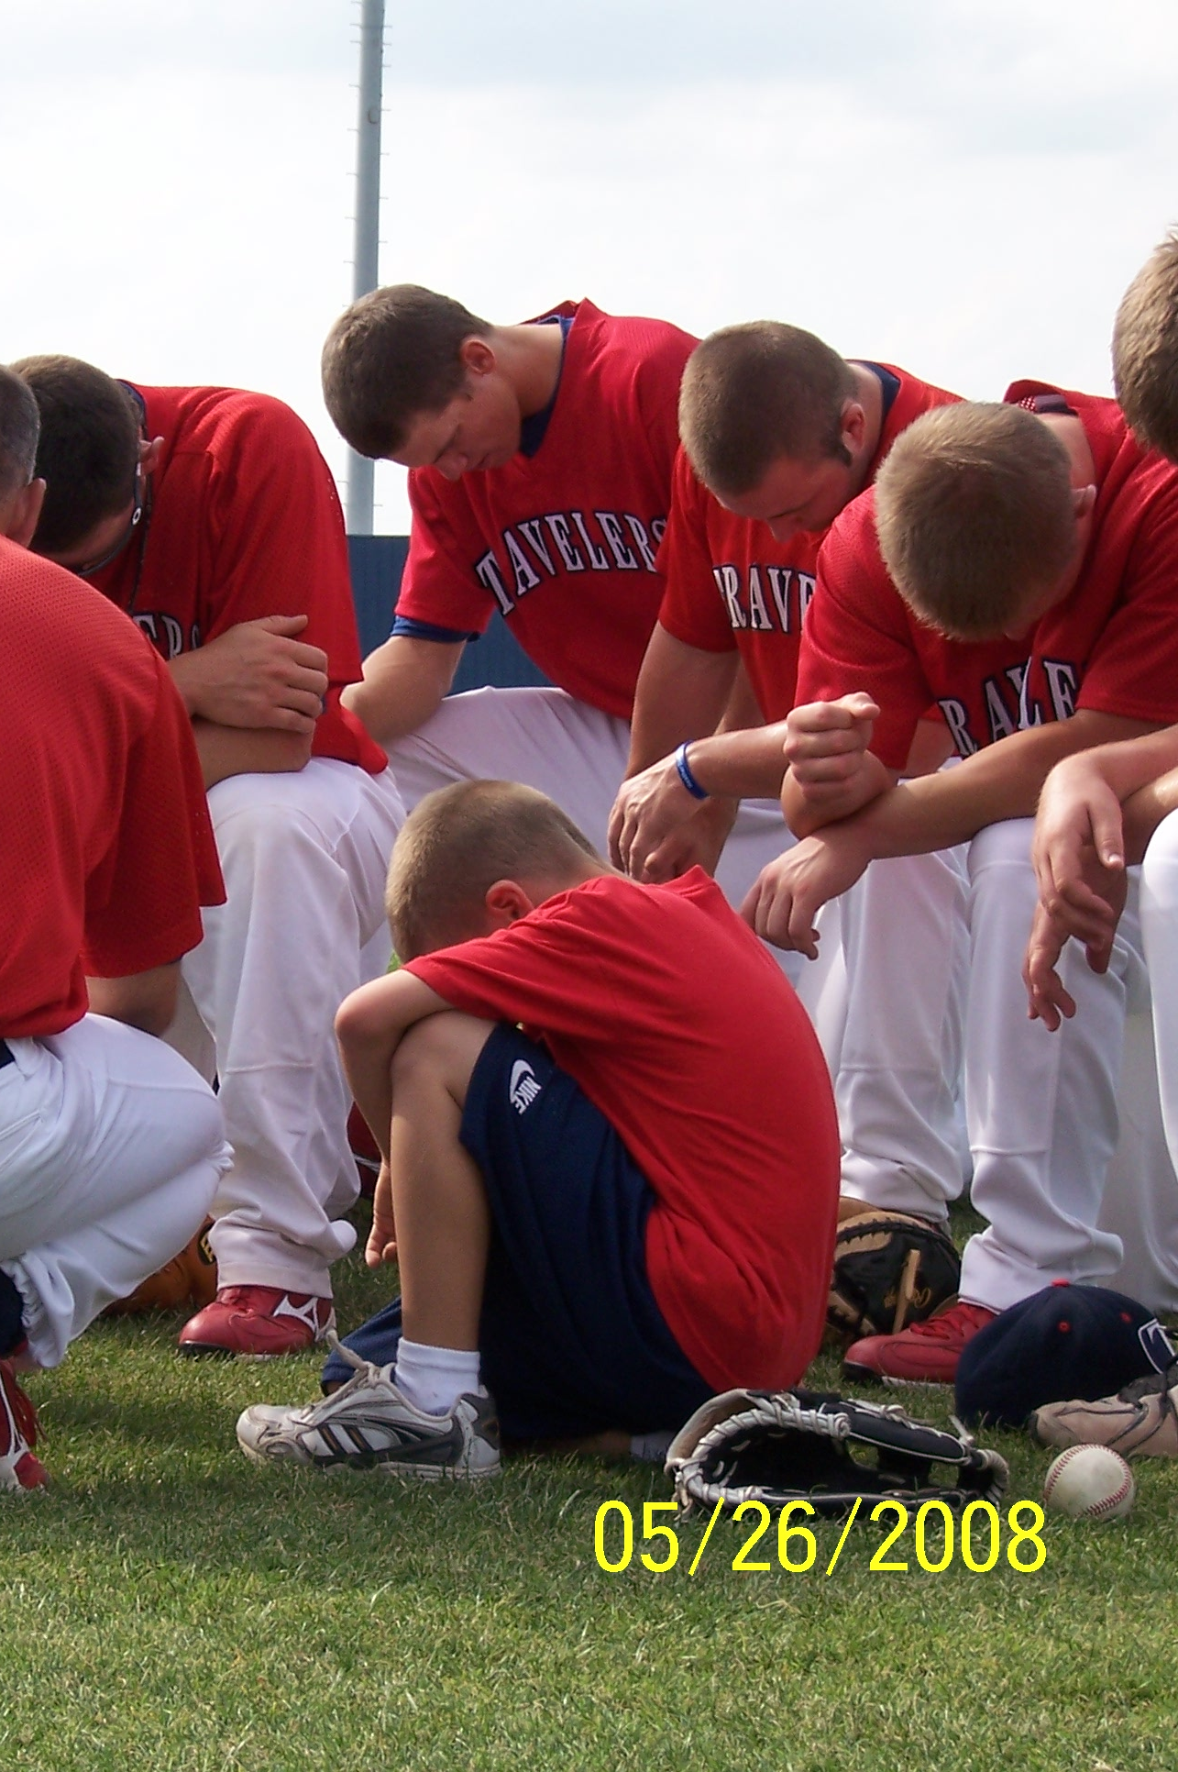
God’s Plan Works!
When the foundation of God’s word is at the center of our approach we have Victory in every situation.
“Team Spirit” promotes God’s foundation, and communication of it, to individuals, groups or teams which allows all situations to be handled with a Godly answer.
After all He is God!

Slide 4
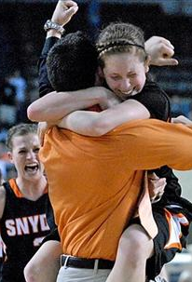
Sport Environment
Team sports place us in a small group environment that resembles the world that we will face as adults. That “sport” environment tests us with success and failure, and the results of our choices will determine our future.
During this journey, we must learn to make decisions that either help or hurt us when seeking “Victory” in life.

Slide 5
outcome without God’s Plan
⇧
Examples

Slide 6
VICTORY with a Biblical/Spiritual answer
⇧
Examples

Slide 7
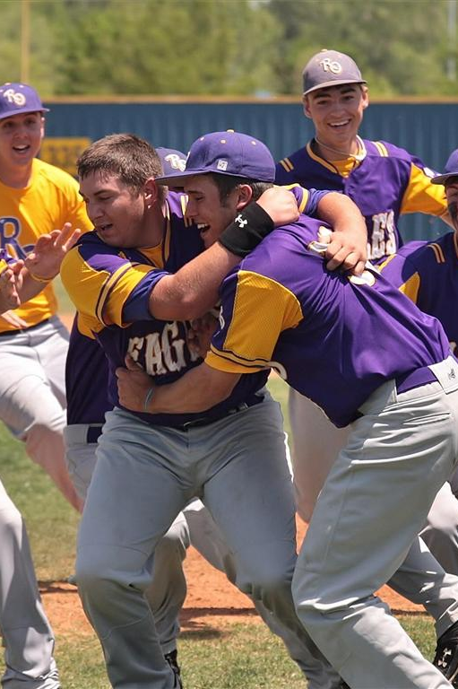
Categories 1 and 2
Galatians 5:19-24
Gal 5:19-21 Now the works of the flesh are evident, which are: adultery, fornication, uncleanness, lewdness, idolatry, sorcery, hatred, contentions, jealousies, outbursts of wrath, selfish ambitions, dissensions, heresies, envy, murders, drunkenness, revelries, and the like; of which I tell you beforehand, just as I also told [you] in time past, that those who practice such things will not inherit the kingdom of God.
Gal 5:22-24 But the fruit of the Spirit is love, joy, peace, longsuffering, kindness, goodness, faithfulness, gentleness, self-control. Against such there is no law. And those [who are] Christ's have crucified the flesh with its passions and desires.
CHOICES: Decisions that we make fall from one of these 2 categories.

Slide 8
Categories 1 and 2
Galatians 5:19-24

Slide 9
Galatians 5:19-21
Works of the Flesh
Fruit of the Spirit
Adultery
Fornication
Uncleanness
Lewdness
Idolatry
Sorcery
Hatred
Contentions
Jealousies
Outbursts of wrath
Selfish ambitions
Dissensions
Heresies
Envy
Murders
Drunkenness
Revelries
Love
Joy
Peace
Longsuffering
Kindness
Goodness
Faithfulness
Gentleness
Self Control

Slide 10
FREEDOM CARDS
Ephesians 5:11 And have no fellowship with the unfruitful works of darkness, but rather expose them.
List 1 thing that you are dealing with (Individually) that you would change.
List 1 thing you believe the team is dealing with that is breaking the team apart.
List 1 thing that you believe the team is dealing with that is bringing the team together.

Slide 11
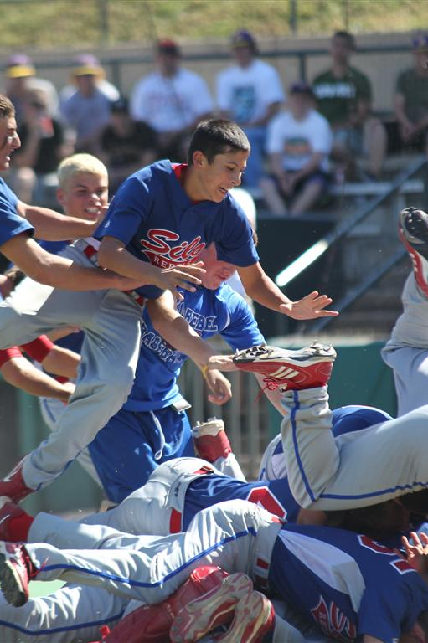
Exposing Issues
James 3:16 “For where envy and self-seeking exists, confusion and every evil thing is present.
Proverbs 11:2 When pride comes, then comes shame; But with the humble is wisdom.
Proverbs 16:8 Pride goes before destruction, and a haughty spirit before a fall. (haughty means arrogant or superiority)
Proverbs 29:23 A man’s pride will bring him low, But the humble in spirit will retain honor.
1 John 2:16 For all that is in the world – the lust of the flesh, the lust of the eyes, and the pride of life- is not of the Father but is of the world.

Slide 12
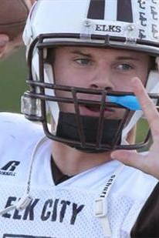
5 Basics
Truth
Choices
Sacrifice
Discipline
Love

Slide 13
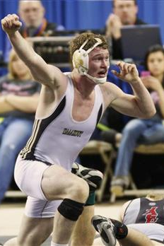
Truth
TRUTH: John 8:31-32 Then Jesus said to those Jews who believed Him, “If you abide in My word, you are My disciples indeed, “And you shall know the truth, and the truth shall make you free.
(This scripture implies that if we are not abiding in God’s word then we are not free but in bondage.)
2 Opinions:
  The Truth of Gods Word
  Opinion of the World (or whatever opinion that has been given us that is not God’s word)
(Whichever we accept is “Truth” to us.)
Consequences: One brings guaranteed Victory the other constant confusion and destruction.

Slide 14
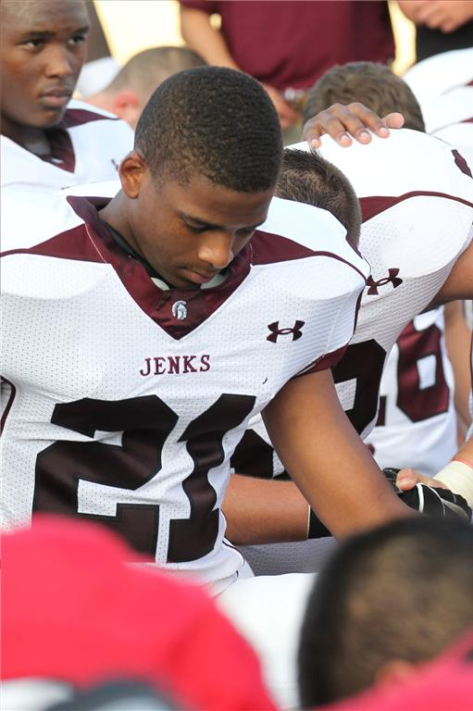
Choices
Deuteronomy 30:19 "I call heaven and earth as witnesses today against you, [that] I have set before you life and death, blessing and cursing; therefore choose life, that both you and your descendants may live;
Jesus is telling us we have a choice!
Make choices based on “TRUTH” of God’s word and not emotions and other peoples opinions.

Slide 15
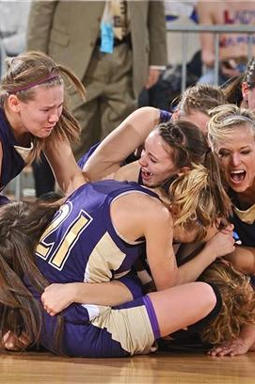
Sacrifice
John 15:13 Greater love hath no man than this, that a man lay down his life for his friends.
John 3:16 “For God so love the world that He gave His only begotten Son, that whoever believes in Him should not perish but have everlasting life.”
*Jesus Christ is our greatest example. It was God’s plan for Jesus to sacrifice Himself for our sin. Through “SACRIFICE” Christ became the biggest winner of all time! It is by modeling His example that champions and heroes are made!
James 4:10 Humble yourselves in the sight of the Lord, and He will lift you up.
Sacrifice brings “Victory!”

Slide 16
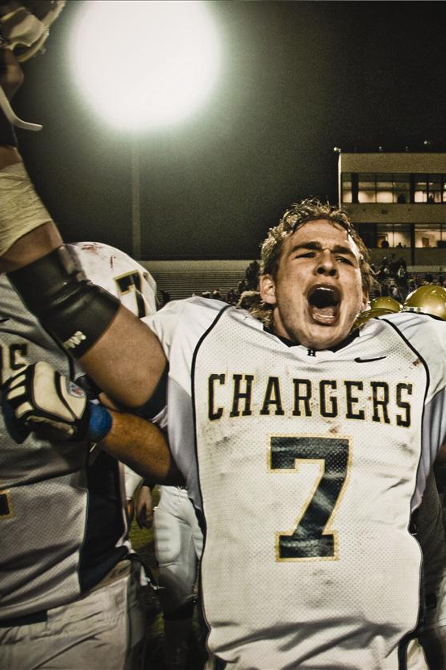
Discipline
Hebrews 12:11. No discipline seems pleasant at the time, but painful. Later on, however, it produces a harvest of righteousness and peace for those who have been trained by it.
2 Types of discipline
  Handed down discipline
  Self discipline
It is the TRUTH of the word that creates character. That character, when matured inside an individual, creates discipline that will carry an individual to their highest potential!

Slide 17
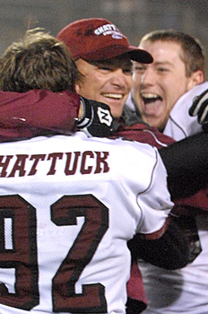
Love
1 Corinthians 13:4-8 Love is patient, love is kind. It does not envy, it does not boast, it is not proud. It is not rude, it is not self-seeking, it is not easily angered, it keeps no record of wrongs, Love does not delight in evil but rejoices with the truth. It always protects, always trusts, always hopes, always perseveres. Love never fails.
John 3:16 “For God so love the world that He gave His only begotten Son, that whoever believes in Him should not perish but have everlasting life.”
God’s Love is the foundation of our existence through the Sacrifice of Jesus Christ.
The greatest potential can be achieved when people LOVE their environment and people in it!

Slide 18
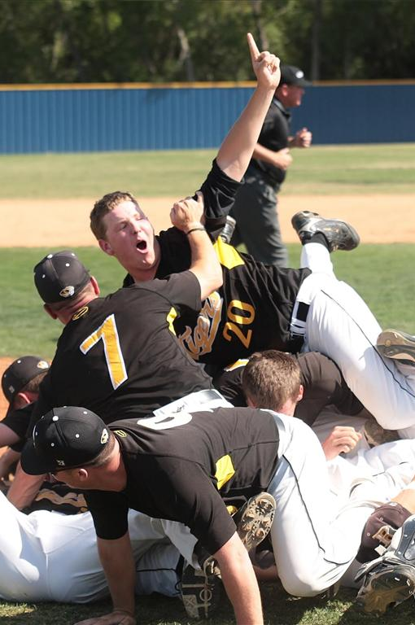
The Results
Each aspect of life deals with a foundation. God made the world and everything in it.
The results of us following His foundation are “VICTORY” in all that it’s applied to.
Ultimately, we are all on one big “TEAM” God’s team, and He has the answers that we need to become better men, women, leaders, husband, wives, mothers and fathers.
“Team Spirit” encourages you to embrace God’s plan through Jesus Christ and reach the Victory and Destiny that God has for you!
AMEN!

Slide 19
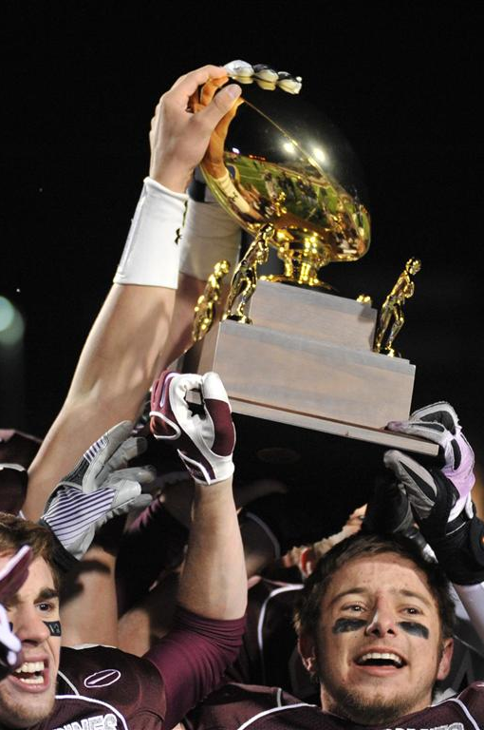
Commitment Challenge
GOAL SETTING
  Matthew 6:33 "But seek first the kingdom of God and His righteousness, and all these things shall be added to you.
PROTECTING THE TEAM
  Psalm 9:11 Those who live in the shelter of the Most High will find rest in the shadow of the Almighty.
FOUNDATION
  Proverbs 10:35 When the whirlwind passes by, the wicked [is] no [more], But the righteous [has] an everlasting foundation.
TEAM HUDDLE
  Discuss the Commitment
  Pray for the Results to create Victory

Slide 20
Victory!
1John 5:1-6 Everyone who believes that Jesus is the Christ has become a child of God. And everyone who loves the Father loves his children, too.
We know we love God's children if we love God and obey his commandments.
Loving God means keeping his commandments, and his commandments are not burdensome.
For every child of God defeats this evil world, and we achieve this victory through our faith.
And who can win this battle against the world? Only those who believe that Jesus is the Son of God.
And Jesus Christ was revealed as God's Son by his baptism in water and by shedding his blood on the cross —not by water only, but by water and blood. And the Spirit, who is truth, confirms it with his testimony.

